Slide 1
Barren Plateaus in Quantum Neural Network Training Landscapes
Jarrod R. McClean, Sergio Boixo, Vadim N. Smelyanskiy, Ryan Babbush & Hartmut Neven
https://www.nature.com/articles/s41467-018-07090-4
Presentation by Thomas Peachey

Slide 2
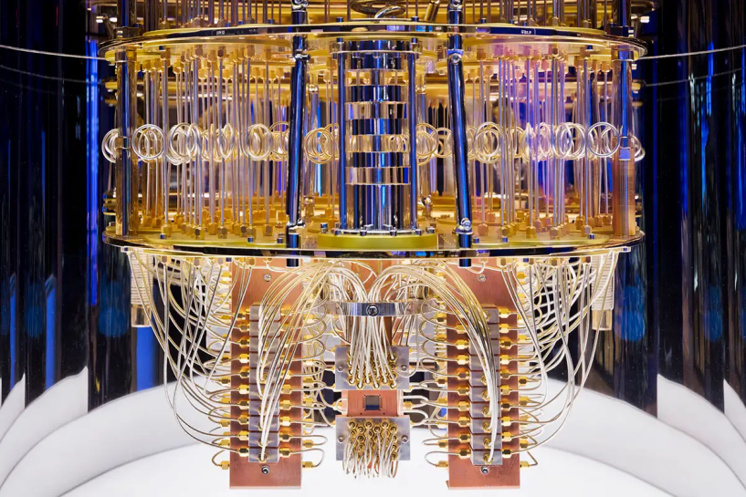
Current quantum computer theory
Many proposals for intermediate scale quantum devices involve training a parameterized quantum circuit with a classical optimization loop.
Such hybrid quantum-classical algorithms are popular for applications in quantum simulation, optimization, and machine learning.
Due to simplicity and hardware efficiency, random circuits are often proposed as initial guesses for exploring the space of quantum states.
fig 1 - IBM Research - Inside a quantum computer

Slide 3
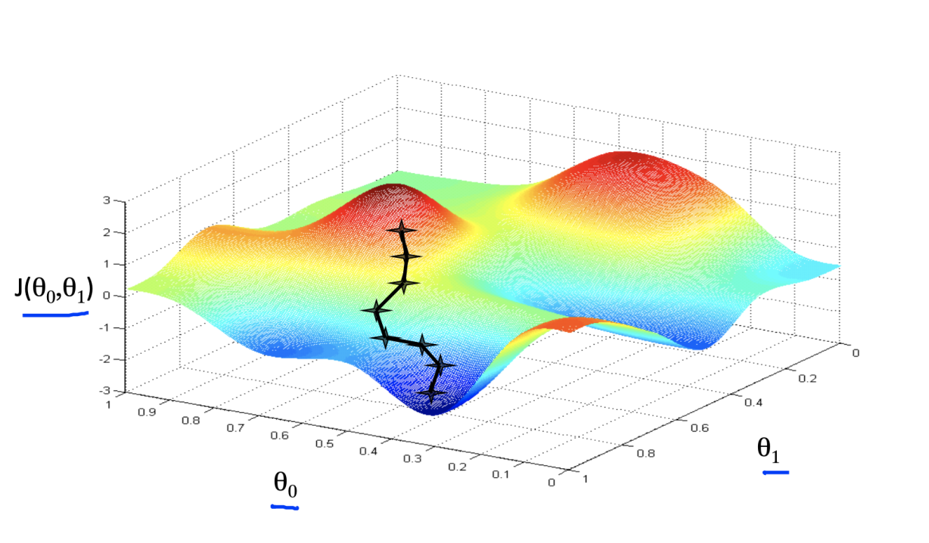
How are these circuits optimised? - Gradient Descent
fig 2 - Celine Surai - https://medium.com/swlh/machine-learning-fundamentals-2-gradient-descent-algorithm-6c8f5204bd9b
A
The basic method for optimising these circuits is gradient descent. This is where an n-dimensional landscape is navigated algorithmically to find the global maxima or minima.
In complex landscapes there may be many local maxima and minima which the algorithm may get stuck in (such as point A on fig 1).
Additional techniques are used to circumvent this (such as taking random walks to find lower/higher points) however getting stuck is always an issue.

Slide 4
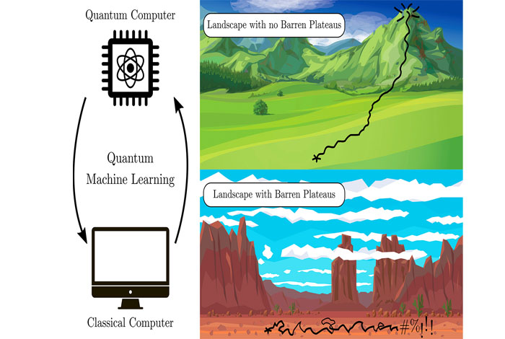
Quantum devices are noisy - so are the optimisation landscapes
However the researchers in this paper found that although at small scales there is a lot of noise, at a more macroscopic scale an extremely small number of quantum states lead to optimization terrain that deviates significantly from a gradient of zero.
The fact that only an exponentially small fraction of states fall outside of this band means that searches resembling random walks will have an exponentially small probability of exiting this “barren plateau”
fig 3 - Los Alamos National Laboratory – A cartoon representation of the problem

Slide 5
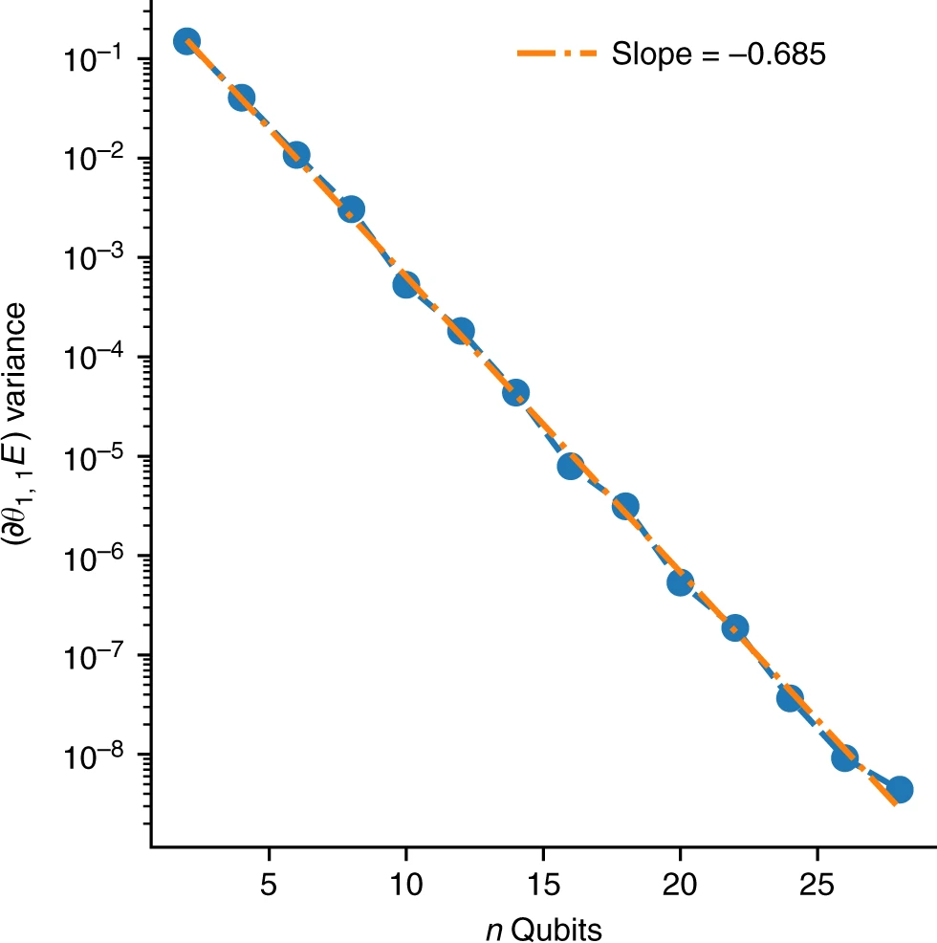
both the expected value of the gradient and its spread decay exponentially as a function of the number of qubits even when the number of layers is a modest linear function.
“These results substantiate our conclusion that gradients in modest-sized random circuits tend to vanish without additional mitigating steps.”
fig 4 - Semi log plot of gradient variance vs number of q-bits (taken from the article)

